Slide 1
Knowledge Discovery And Data Mining project
Android Health-Check

Slide 2
TEAM members
Android Health Check
MONISH KANNA SURESH
RASHI WASE
AKSHITHA REVU​
CWID: 20012129
CWID: 20011374
CWID: 20011360

Slide 3
AGENDA
Problem Statement
Dataset
EDA
​Algorithms
​Summary​
Conclusion

Slide 4
Problem statement
Developing and analyzing different machine learning algorithms for the detection of malware in the Android operating system.

Slide 5

dataset
Android Health Check
The dataset for Android Malware Detection comprises a variety of malware APK files with diverse characteristics, offering a valuable resource for employing machine learning algorithms in the detection of malicious software.
https://figshare.com/articles/dataset/Android_malware_dataset_for_machine_learning_2/5854653
16300 rows
215 features
1 target variable (B,S)

Slide 6
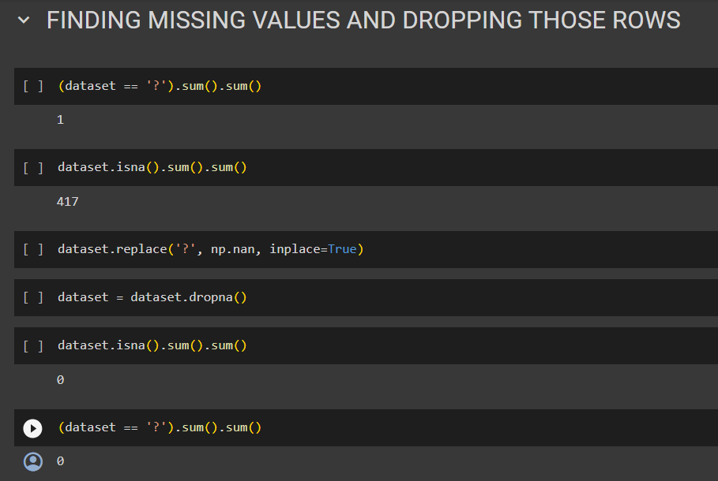
Handling missing values
Android Health Check

Slide 7
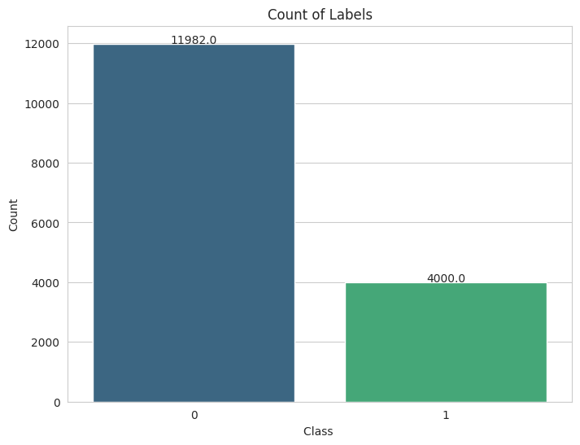
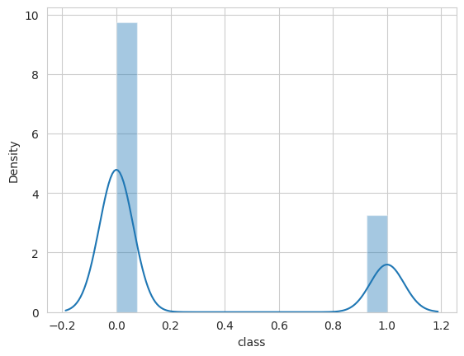
Data visualisation
Android Health Check

Slide 8
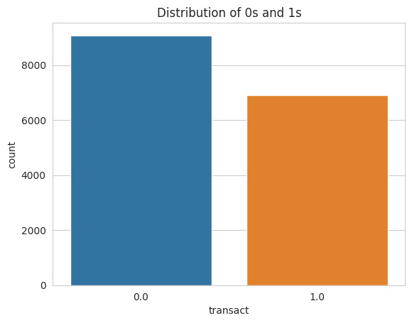
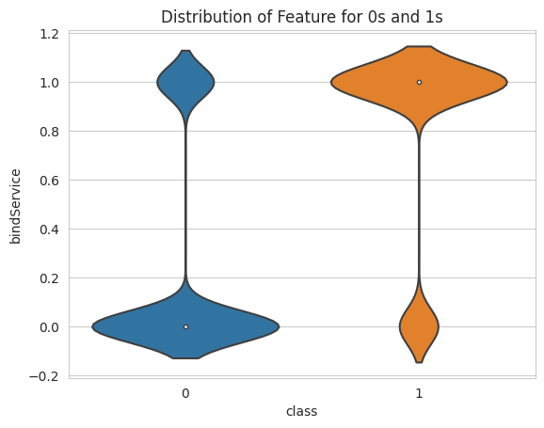
Data visualisation
Android Health Check

Slide 9
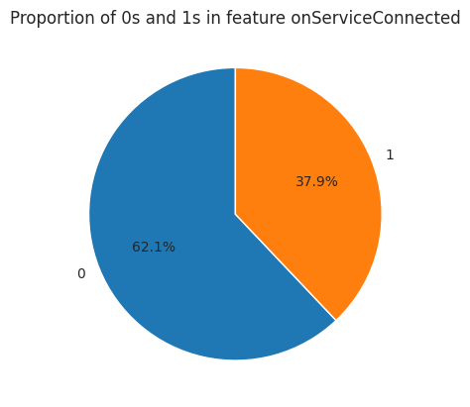
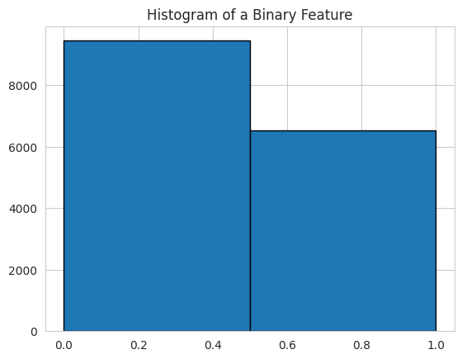
Data visualisation
Android Health Check

Slide 10
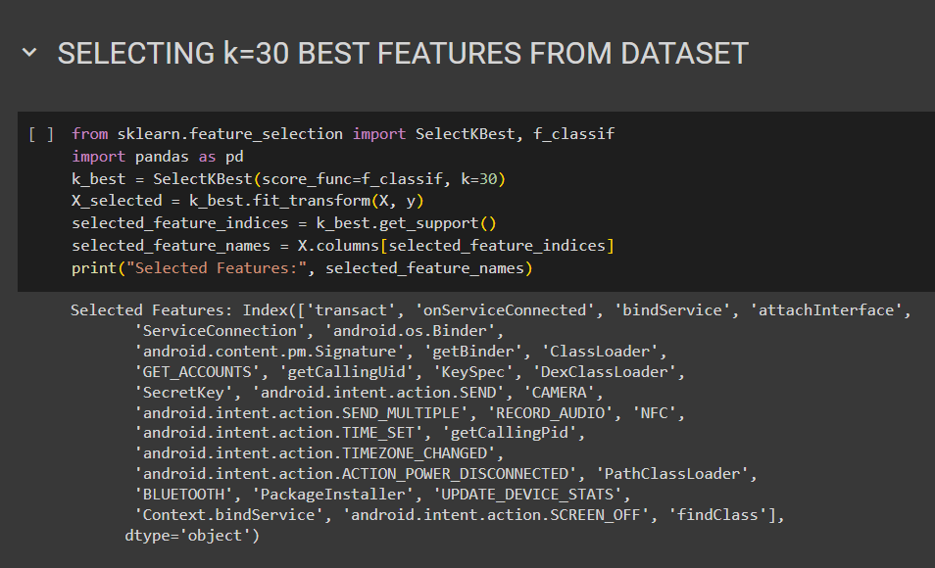
Feature selection
Android Health Check

Slide 11
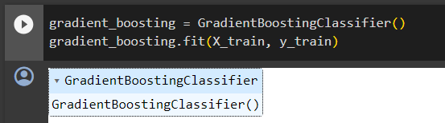
Gradient Boost
Android Health Check
Gradient Boost constructs a series of weak learners sequentially, and each tree corrects the errors of the previous one. It optimizes a cost function, adjusting the weights of misclassified instances. The final model combines the predictions of all trees, resulting in a robust and accurate model.

Slide 12
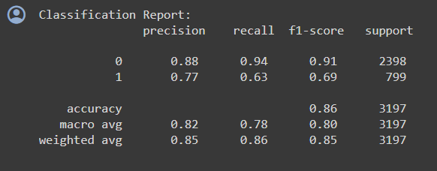
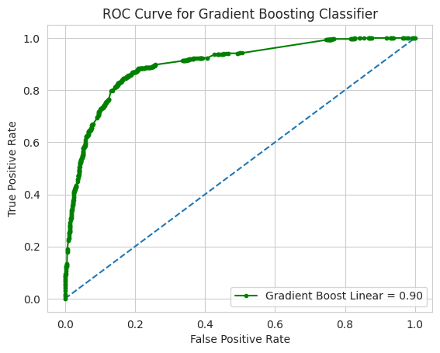
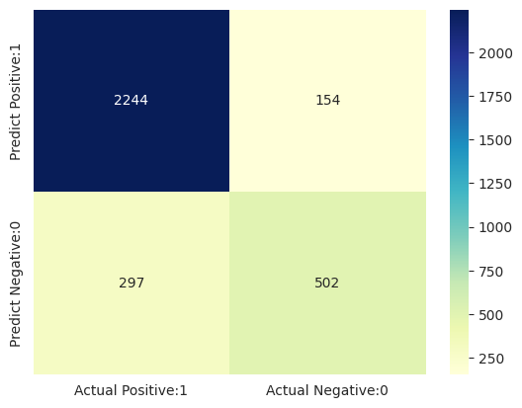
Gradient Boost
Android Health Check

Slide 13
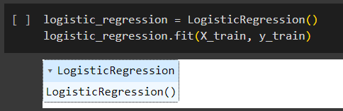
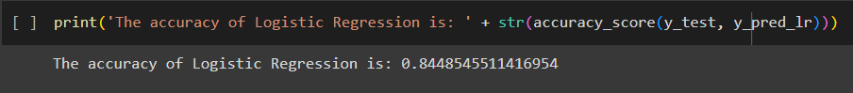
Logistic Regression
Android Health Check
Logistic Regression is a linear model for binary classification that uses the logistic function to model the probability of a particular class. It is widely used for its simplicity and interpretability.
Logistic Regression models the probability of a binary outcome using the logistic function. It estimates coefficients for each feature, and the model is trained through maximum likelihood estimation. Logistic Regression is interpretable and suitable for understanding the impact of individual features on malware detection.

Slide 14
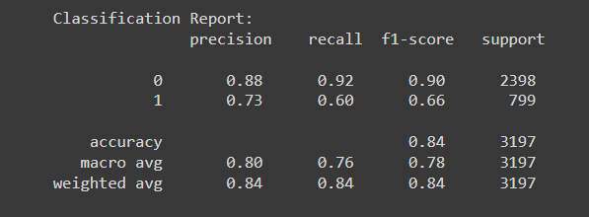
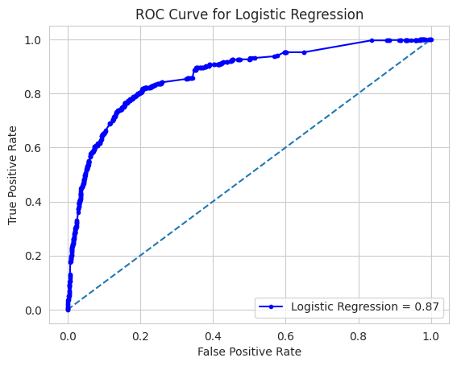
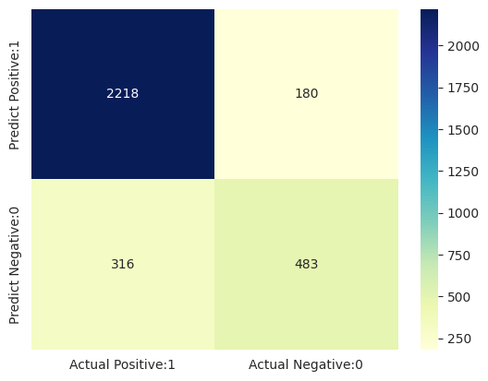
Logistic Regression
Android Health Check

Slide 15
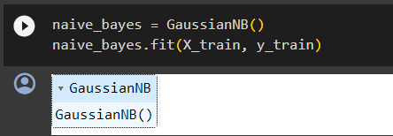
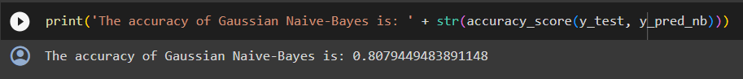
Naive Bayes
Android Health Check
Naive Bayes is a probabilistic algorithm based on Bayes' theorem. Despite its simplicity, it is effective for classification tasks. It assumes independence between features, making it computationally efficient.
Naive Bayes calculates the probability of a class given the input features using Bayes' theorem. Despite assuming feature independence, it performs well in practice. It is computationally efficient and particularly effective when dealing with large datasets.

Slide 16
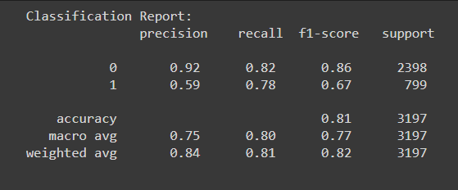
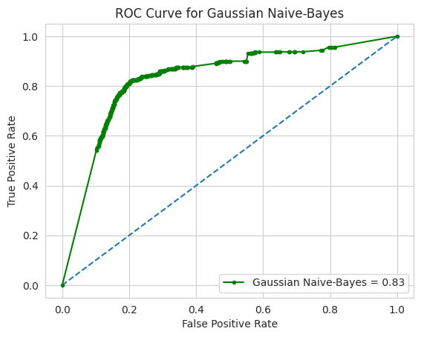
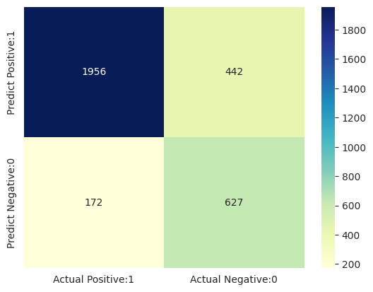
Naive Bayes
Android Health Check

Slide 17
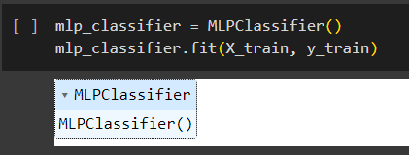
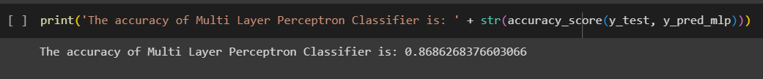
MLP
Android Health Check
Multilayer Perceptron (MLP) is a type of artificial neural network with multiple layers. It excels in capturing complex relationships in data and is widely used in various domains, including malware detection.
Multilayer Perceptron consists of layers of interconnected nodes with weighted connections. Through forward and backward propagation, it adjusts the weights to minimize the error between predicted and actual values. This neural network architecture enables MLP to capture complex, non-linear relationships in the data.

Slide 18
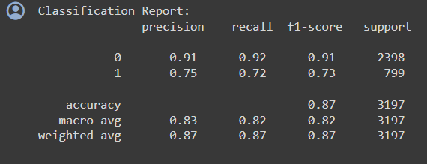
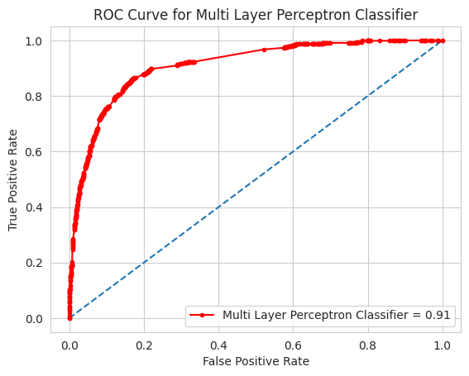
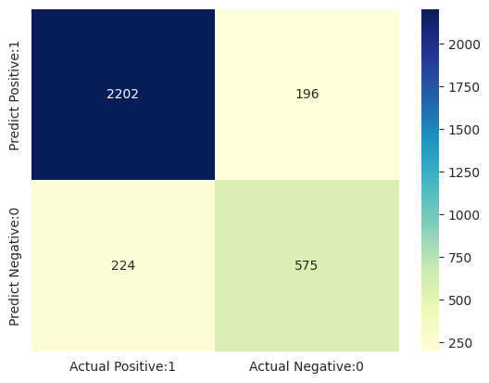
MLP
Android Health Check

Slide 19
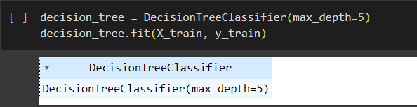
Decision Tree
Android Health Check
Decision Tree is a tree-like model that makes decisions based on a series of conditions. It is easy to understand and interpret, making it suitable for explaining the decision-making process in malware detection.
Decision Tree recursively splits the data based on feature conditions, creating a tree-like structure. It selects the most informative features at each node to maximize information gain or minimize impurity.

Slide 20
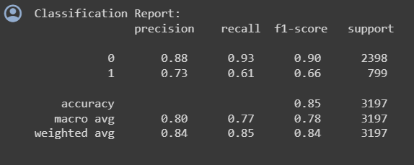
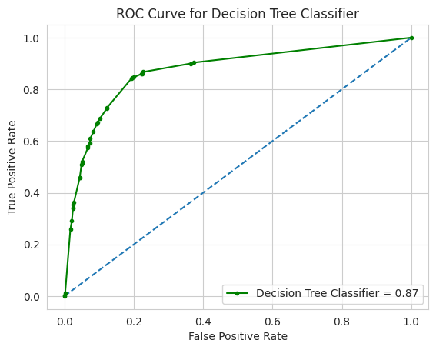

Decision Tree
Android Health Check

Slide 21
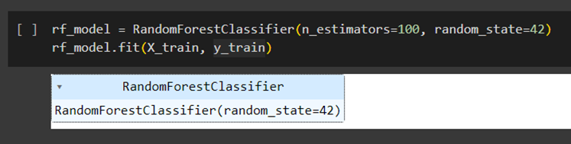
Random forest
Android Health Check
Random Forest is an ensemble learning algorithm that constructs a multitude of decision trees during training and outputs the mode of the classes for classification. It excels in handling large datasets and is robust against overfitting.
Random Forest builds multiple decision trees during training and outputs the mode of the classes for classification. Each tree is constructed using a random subset of the features and a random subset of the training data. This randomness helps to reduce overfitting and enhance generalization.

Slide 22
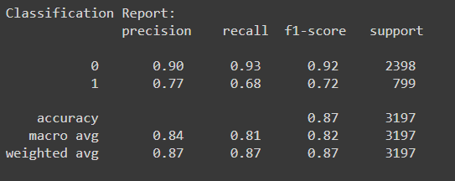
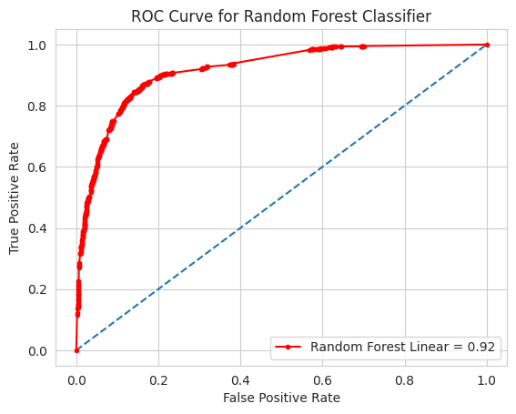
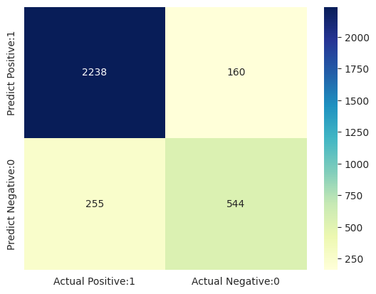
Random Forest
Android Health Check

Slide 23
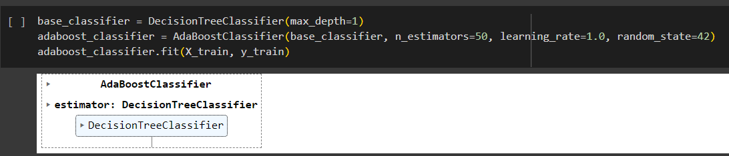
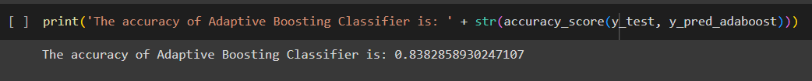
AdaBoost
Android Health Check
AdaBoost is an ensemble learning method that combines weak classifiers to form a strong one. It assigns weights to instances and focuses on the misclassified ones in subsequent iterations, improving overall performance.
AdaBoost combines weak classifiers by assigning weights to instances and focusing on misclassified ones in subsequent iterations. It adapts by adjusting weights to give more importance to difficult-to-classify instances. This iterative approach strengthens the overall model's performance, making it resilient against overfitting.

Slide 24
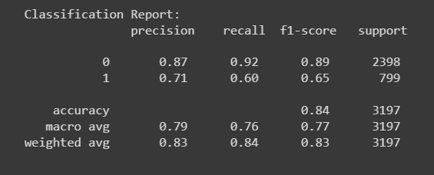
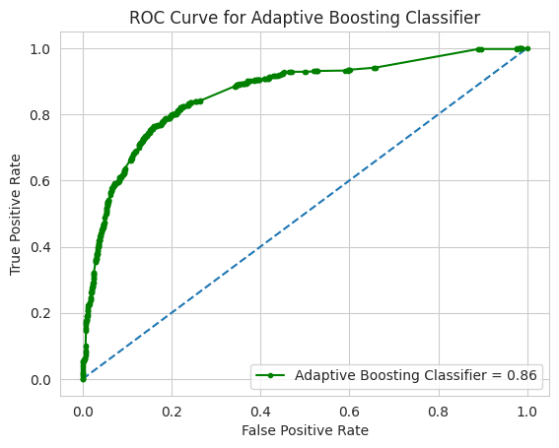

AdaBoost
Android Health Check

Slide 25
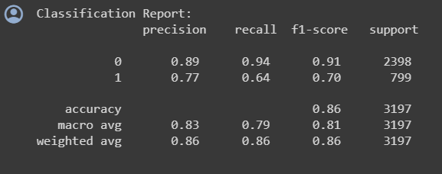
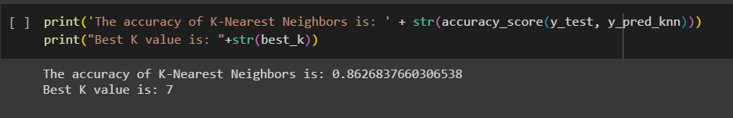
KNN
Android Health Check
K-Nearest Neighbors is a simple and intuitive algorithm for classification. It assigns a class label based on the majority class of its k nearest neighbors in the feature space.
K-Nearest Neighbors classifies data points based on the majority class of their k nearest neighbors. It is sensitive to the choice of k and distance metric. KNN is particularly effective when dealing with local patterns in the data, making it suitable for identifying clusters of malicious activity.

Slide 26
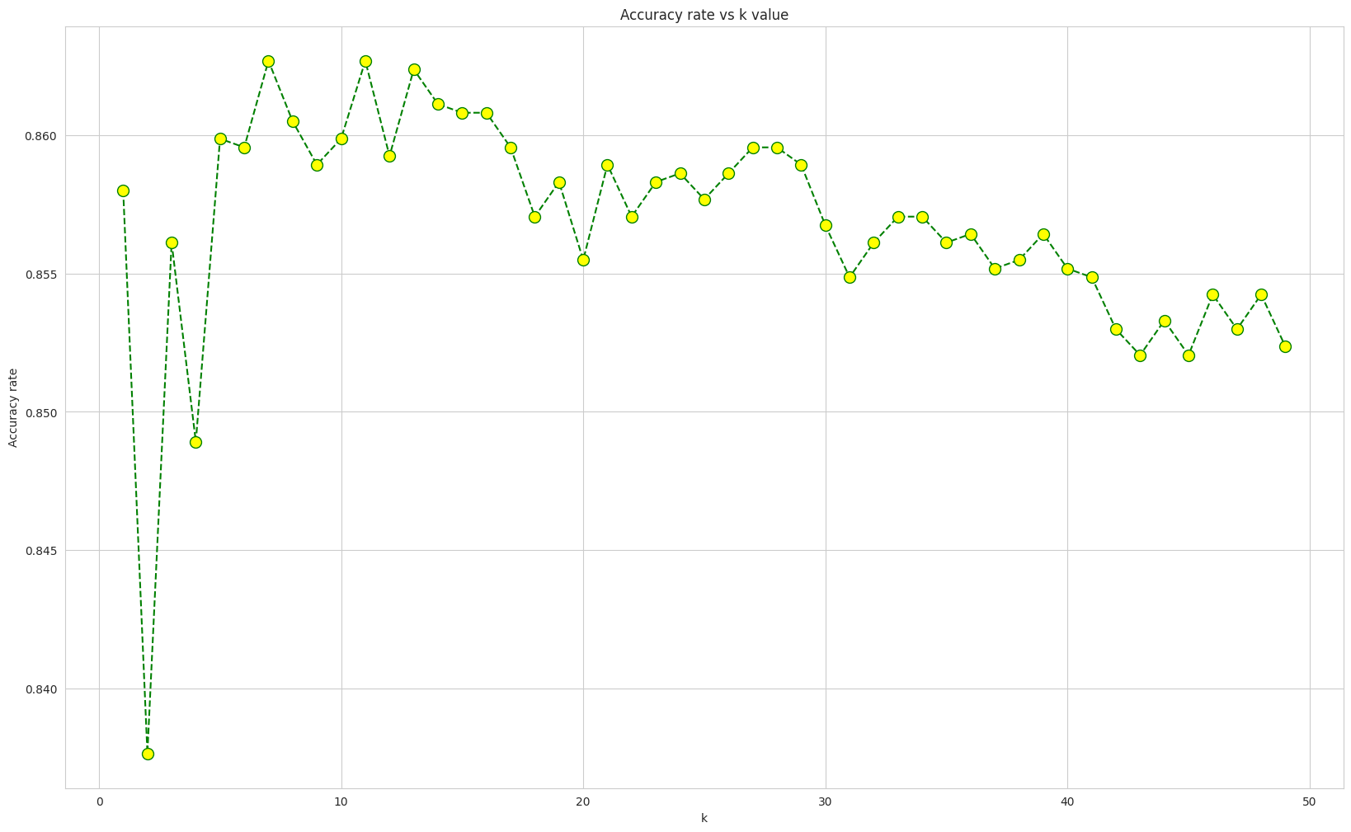
KNN
Android Health Check

Slide 27
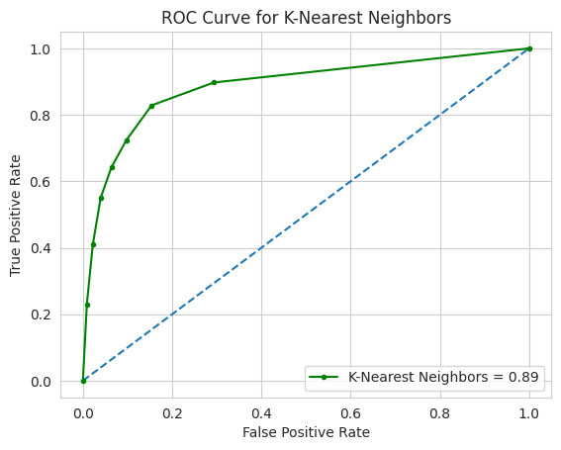

KNN
Android Health Check

Slide 28
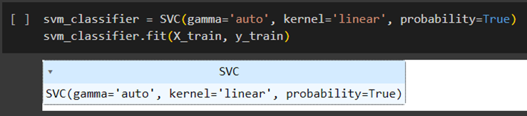
SVM linear kernel
Android Health Check
Support Vector Machine (SVM) with a linear kernel is a classification algorithm that separates data points by finding the hyperplane that maximizes the margin between classes in a high-dimensional space.
Support Vector Machine with a linear kernel finds the hyperplane that maximizes the margin between classes in the input space. It works well for linearly separable data and is efficient in high-dimensional spaces, making it suitable for malware detection datasets with complex feature spaces.

Slide 29
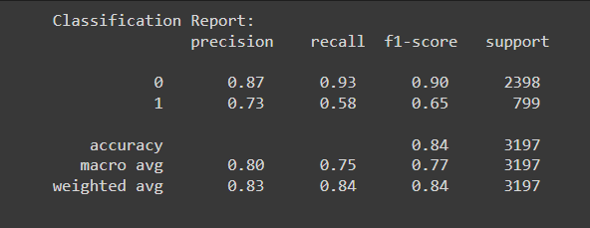
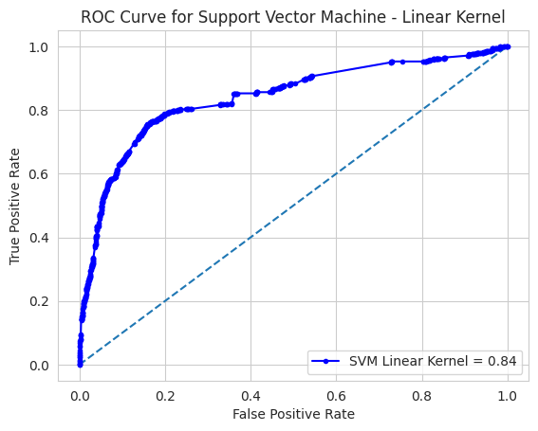

SVM linear kernel
Android Health Check

Slide 30
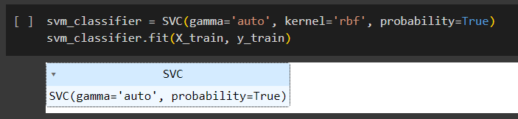
Svm rbf kernel
Android Health Check
SVM with Radial Basis Function (RBF) kernel is a nonlinear SVM that transforms the input data into a higher-dimensional space. It is effective in handling complex decision boundaries and is widely used for malware detection.
The RBF kernel computes the similarity between data points, allowing SVM to capture intricate relationships in the dataset, enhancing its malware detection capabilities.

Slide 31
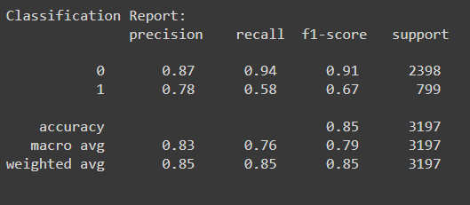
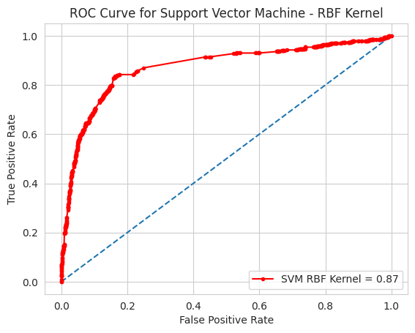
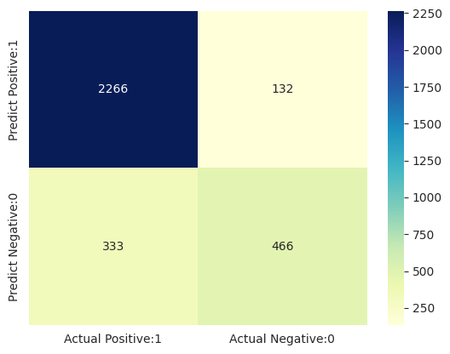
Svm rbf kernel
Android Health Check

Slide 32
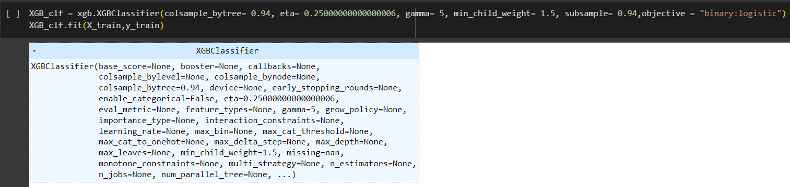
XgBoost
Android Health Check
XgBoost is an optimized gradient boosting algorithm that incorporates regularization terms and parallel processing. It uses a combination of weak learners and employs a second-order approximation to optimize the loss function. XgBoost's efficiency and scalability make it a popular choice for large-scale malware detection datasets.

Slide 33




XgBoost
Android Health Check

Slide 34
 | Accuracy | F1 score 0 1 |  | Precision 0 1 |  | Recall 0 1
Random Forest | 0.87 | 0.92 | 0.72 | 0.90 | 0.77 | 0.93 | 0.68
Gradient Boosting | 0.86 | 0.91 | 0.69 | 0.88 | 0.77 | 0.94 | 0.63
SVM Linear kernel | 0.84 | 0.90 | 0.65 | 0.87 | 0.73 | 0.93 | 0.58
SVM RBF kernel | 0.85 | 0.91 | 0.67 | 0.87 | 0.78 | 0.94 | 0.58
KNN (k=7) | 0.86 | 0.91 | 0.70 | 0.89 | 0.77 | 0.94 | 0.64
MLP | 0.87 | 0.91 | 0.73 | 0.91 | 0.75 | 0.92 | 0.72
Gaussian NB | 0.81 | 0.86 | 0.67 | 0.92 | 0.59 | 0.82 | 0.78
Logistic Regression | 0.84 | 0.90 | 0.60 | 0.88 | 0.73 | 0.92 | 0.60
Decision Tree | 0.85 | 0.90 | 0.66 | 0.88 | 0.73 | 0.93 | 0.61
AdaBoost | 0.84 | 0.89 | 0.65 | 0.87 | 0.71 | 0.92 | 0.60
XgBoost | 0.86 | 0.91 | 0.69 | 0.88 | 0.76 | 0.93 | 0.63
SUMMARY

Slide 35
conclusion
Android Health Check
Random Forest works better for Android Health Check dataset as it holds a higher accuracy.
In summary, the Android Malware Detection Dataset, with its diverse malware APK files, showcases the effectiveness of machine learning algorithms in bolstering cybersecurity for Android devices. By addressing the limitations of traditional methods, this dataset provides a robust foundation for training and evaluating detection models.
As mobile devices face increasing cybersecurity threats, the significance of employing machine learning for malware detection is underscored. The rich attributes of the dataset position it as a valuable asset in enhancing the security of Android ecosystems. This research signals a promising direction for further exploration and refinement of machine learning solutions to tackle evolving cybersecurity challenges in the mobile domain.

Slide 36
THANK YOU

